Slide 1

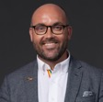

Welcome to NYC
Dear Australian Retail Leaders,
As someone who has attended NRF for over 10 years, both as a retailer and an industry analyst, I can confidently say that it’s back to being one of the most transformative experiences for leaders in our industry. The NRF Big Show is a powerhouse of insights, ideas, and innovations, but here’s the truth: the real magic happens not just on the show floor or in the sessions. It’s what takes place around the halls, in the conversations, and in the unique opportunities to connect with global thought leaders that provide the most value.
We understand that building the business case to attend NRF can be a challenge—especially when costs are under scrutiny. But while costs are important, so too are the opportunities you’ll miss by not engaging with the future of retail. The insights, inspiration, and strategies you’ll bring back from NRF aren’t just beneficial—they’re essential for sustainable growth.
This guide was designed specifically for you—Australian retailers—because we know how critical it is to maximize the value of your time at NRF. It's not just about attending sessions; it’s about making the most of every opportunity to learn, network, and gather the inspiration that will fuel the future of your business. We’ve created this document in a way that you can simply cut and paste and build in your answers.
We hope this guide helps you build the business case, navigate the event, and ultimately bring back the insights that will drive your company forward.
Looking forward to seeing you in New York,
Andrew Smith
Co-Founder & Managing Partner
ThinkUncommon

Slide 2

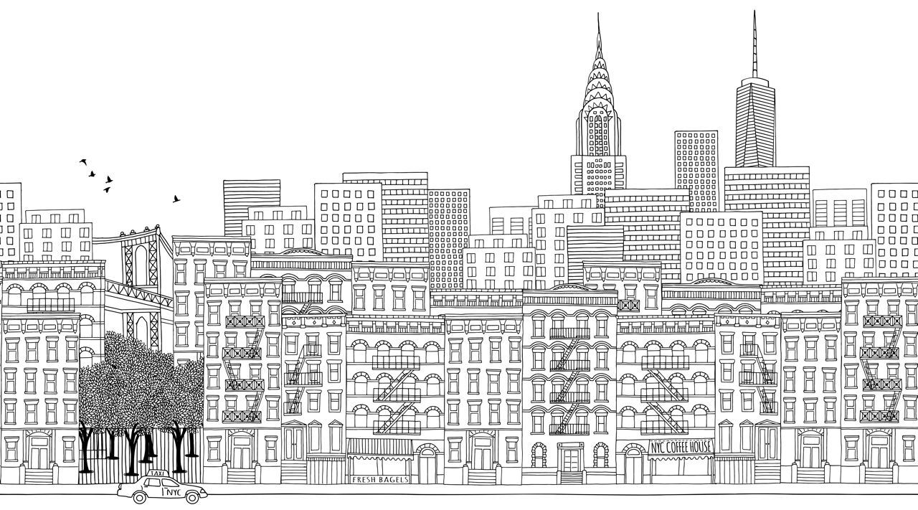
TITLE PAGE
Retail’s Big Show NRF25

Slide 3
35,000+
600+
950+
100+
Attendees
Retail Reporters and Analysts
Exhibitors
Countries
A Game-Changer Event: Why We Should Attend.
Keeping ahead of competition is essential to keeping customers happy and growing profits. NRF is known for setting the global agenda in retail innovation, offering insights into next-generation technologies. Over 175+ sessions will explore trends like AI, blockchain, and customer engagement.
Artificial Intelligence (AI) and Automation
• AI Dominance: AI will remain a dominant force at NRF 2025, with widespread applications across customer personalization, inventory management, and supply chain optimization. AI helps streamline operations by analyzing vast amounts of data to predict customer behaviors and improve decision-making (Retail TouchPoints, 2024).
Sustainability and ESG
• Sustainability as a Priority: Retailers are increasingly adopting Environmental, Social, and Governance (ESG) frameworks to meet consumer demand for ethical and sustainable products. NRF 2025 will showcase how sustainability drives consumer loyalty, with brands like IKEA and PepsiCo leading the way (Retail TouchPoints, 2024).
• Circular Economy Models: Expect a focus on circular economy initiatives, with examples like IKEA’s “As-is” resale program that anchors customers in mission-driven shopping (Retail TouchPoints, 2024).
Customer-Centric Innovation
• Elevating Customer Experience: Personalization and convenience are at the core of NRF 2025 discussions. Technologies like RFID, self-checkout, and AI-driven product recommendations are creating more satisfying customer experiences, with some retailers reporting a 10-20% increase in customer retention (RETHINK Retail, 2024; ToolsGroup, 2024).
• Hyper-Personalization: AI enables retailers to offer real-time tailored experiences. Studies indicate that consumers who experience personalized interactions are 40% more likely to make repeat purchases (Retail TouchPoints, 2024).
Supply Chain
• Supply Chain Resilience: AI-driven solutions are optimizing supply chains by providing real-time insights, helping retailers respond faster to disruptions. NRF 2025 will discuss how unified commerce systems, supported by AI and machine learning, ensure that retailers meet customer expectations (ToolsGroup, 2024).

Slide 4

Key Players & Networking Opportunities
Vendors & Suppliers
International Retailers
Deeper relationships with vendors can release profitable opportunities. All the top retail focused vendors have their international leadership teams in attendance + their latest tech on show. Access to roadmaps , strategy insights , influence on products not easily available in Aus.
Forming relationships with retailers facing the same challenges but in different geographies presents great opportunity to learn from their experience
I will seek to connect with:
…
…
…
Full list here: Who Attends | NRF 2025: Retail's Big Show (nrfbigshow.com)
I hope to arrange meetings with:
…
…
…
(Some examples: Microsoft AI, Salesforce, Google, AWS – full list of those confirmed available here: NRF 2025: Retail's Big Show Exhibitors List (nrfbigshow.com))

Slide 5

Unique Startups & Innovations
Meet the Game Changers
NRF Requirements of Innovators Showcase
Technologies that solve a problem for retailers and is new to the market (within the past three years)
Technologies demonstrating the latest advances including artificial intelligence, extended reality, robotics, facial recognition, automotive, logistics, machine learning, supply chain, Web3 and data analytics
Technologies that are live in a retailer or in the pilot phase (no concept phase is permitted)
Cannot have previously participated in the Lab (2017-2024) unless showcasing a new product or service that is entirely unrelated to past demonstrations
Exciting technology demonstrations that are interactive and immersive
NRF25 Confirmed So Far: Innovators | NRF 2025: Retail's Big Show (nrfbigshow.com)
The NRF 2025 Innovators Showcase as well as the Startup Hall will be a platform for cutting-edge retail startups, many of which go on to secure major investments from companies like Google, Walmart, and Apple.
I look forward to finding how the newest startups are responding to these challenges
…
…
…

Slide 6
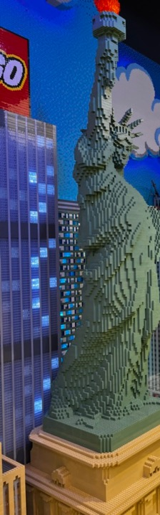
Retail Store Tours
Inspiration in Action
NRF 2025’s Uncommon Safari store tours allow retailers to see firsthand how global brands in New York City, New Jersey, and Brooklyn are adopting digital-first experiences, inspiring operational and customer service improvements. Stores include;
The Tours in 2025
Innovation in Manhattan: with a focus on in-store experience, design, and tech-enabled retail, Manhattan offers an array of unique and creative stores to seek inspiration from
Real-America in Jersey: New Jersey is a home to every well-known American Brand (Walmart, Best Buy, Lowe’s Home Depot, Target, and more) as well as American Dream Mall which is undergoing yet another inventive shift to its value proposition
Sustainable Brooklyn: Brooklyn has a highly-focused environmentally and socially conscious shopper demographics, and big brands like Wegmans are responding.
Quarters (shopquarters.com)
Crate & Barrel Flagship
Macy’s Rejuvenation
Walmart Tech Hub
Best Buy Flagship
Just Walk Out Tech-enabled Sites
… (add in what you would like to see)

Slide 7

Making the most of it.
Our Agenda
There are several specific projects and ambitions that would be validated or initiated through the work done at NRF 2025.
Project/Focus Area | Value of Trip
The Team
Additional Locations
To make the most of the investment, core team members should attend together to maximize the outcomes from the investment whilst also focusing our actions on return. I recommend the following team members attend:
…
…
Again, to make the most of the time taken away to gather insight, inspiration, and validation, we recommend having the following side trips:
Location | Purpose

Slide 8
Making the most of it.
The Expected Return
There are several specific projects and ambitions that would be validated or initiated through the work done at NRF 2025.
Item/Innovation | Description | Potential Value | Investment Required | ROI Justification
Innovation/Technology | Brief explanation of what the innovation is and its impact on retail (e.g., AI-powered personalization, RFID tracking) | Estimated dollar value of increased revenue, reduced costs, or efficiencies | Cost of implementing the technology or adopting the strategy | How the investment leads to growth, cost savings, or enhanced customer satisfaction

Slide 9
Making the most of it.
Some Examples to Help Your Thinking
AI-Powered Personalization
Description: AI-driven personalization tools help retailers deliver tailored experiences based on customer behavior, leading to increased sales and customer loyalty.
Potential Value:
Revenue Uplift: Studies show that personalization can boost revenue by 10-15%
Improved Conversion Rates: Retailers using AI have reported conversion rate increases of 20-30%.
Investment Required:
Cost: AI software integration, training, and ongoing data analysis costs. Estimated at AUD $100,000 to $200,000 for a medium-sized retailer.
ROI Justification:
If personalized experiences lead to a 5% increase in average order value, that could represent an additional AUD $500,000 annually for a retailer with AUD $10 million in revenue.
RFID for Inventory and Shrinkage Control
Description: RFID helps track inventory in real-time, reducing stockouts and improving inventory accuracy.
Potential Value:
Shrinkage Reduction: RFID can reduce shrinkage by up to 15-20%, which is significant considering that shrinkage costs retailers billions annually​
Inventory Turnover: Retailers implementing RFID have seen improvements in turnover by 8-10%.
Investment Required:
Cost: Installation of RFID systems, RFID tags for products, and ongoing software fees. For a mid-size retailer, the cost might be around AUD $300,000.
ROI Justification:
Shrinkage reduction of 15% for a retailer losing AUD $1 million annually to shrinkage could save them AUD $150,000. The payback period for RFID implementation would be approximately 2 years.
Sustainability Initiatives (Circular Economy)
Description: Implementing sustainable practices like resale or recycling programs (e.g., IKEA’s resale initiative).
Potential Value:
Consumer Demand: 70% of consumers prefer to purchase from companies that are environmentally conscious​
Brand Loyalty: Sustainable practices can lead to 10% higher brand loyalty.
Investment Required:
Cost: Implementing recycling systems or resale platforms could cost AUD $100,000 for system setup and marketing.
ROI Justification:
Increased loyalty and positive brand perception could drive a 5% increase in revenue, which for a retailer with AUD $15 million in revenue, would mean an additional AUD $750,000 annually.
Unified Commerce (Omnichannel Solutions)
Description: Unifying online and offline data for seamless customer experiences (e.g., click-and-collect, mobile checkout).
Potential Value:
Sales Growth: Retailers with strong omnichannel capabilities have seen a 7-10% increase in sales​ Customer Retention: Unified experiences increase customer retention by 15-20%.
Investment Required:
Cost: Technology integration and workforce training for a mid-size retailer might range from AUD $250,000 to $500,000.
ROI Justification:
A retailer with AUD $20 million in revenue could increase sales by AUD $1.4 to $2 million annually, justifying the investment within the first year.

Slide 10
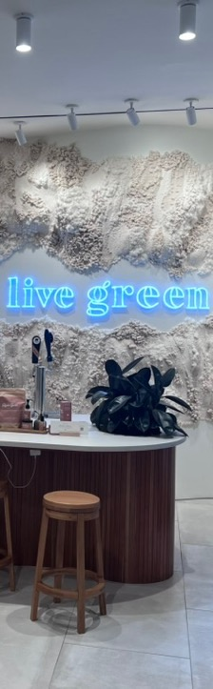
Expected Costs
Maximizing Value
We have calculated costs as per below, as well as a collected a few data points that have been recorded by brands as returns from projects related to NRF topics, partnerships, and insights:
Type | Cost
Airfares
Accommodation
Tickets
General Expenses
…
Retailers integrating AI into omnichannel commerce have seen sales grow by 8-10% (Retail TouchPoints, 2024).
Studies indicate that consumers who experience personalized interactions are 40% more likely to make repeat purchases (Retail TouchPoints, 2024).
Brands using AI for demand forecasting and real-time inventory management are experiencing up to a 25% reduction in stockouts (RETHINK Retail, 2024).
Technologies like RFID, self-checkout, and AI-driven product recommendations are creating more satisfying customer experiences, with some retailers reporting a 10-20% increase in customer retention (RETHINK Retail, 2024; ToolsGroup, 2024).

Slide 11

TITLE PAGE
Retail’s Big Show NRF25

